Slide 1
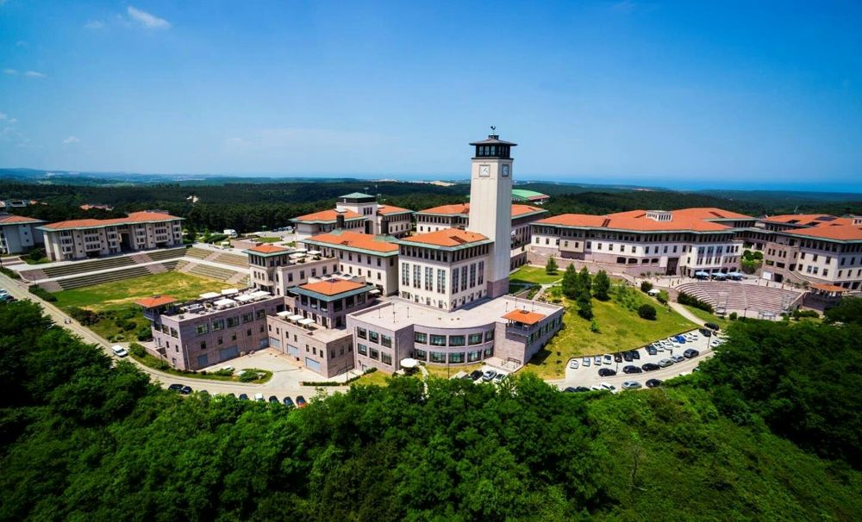
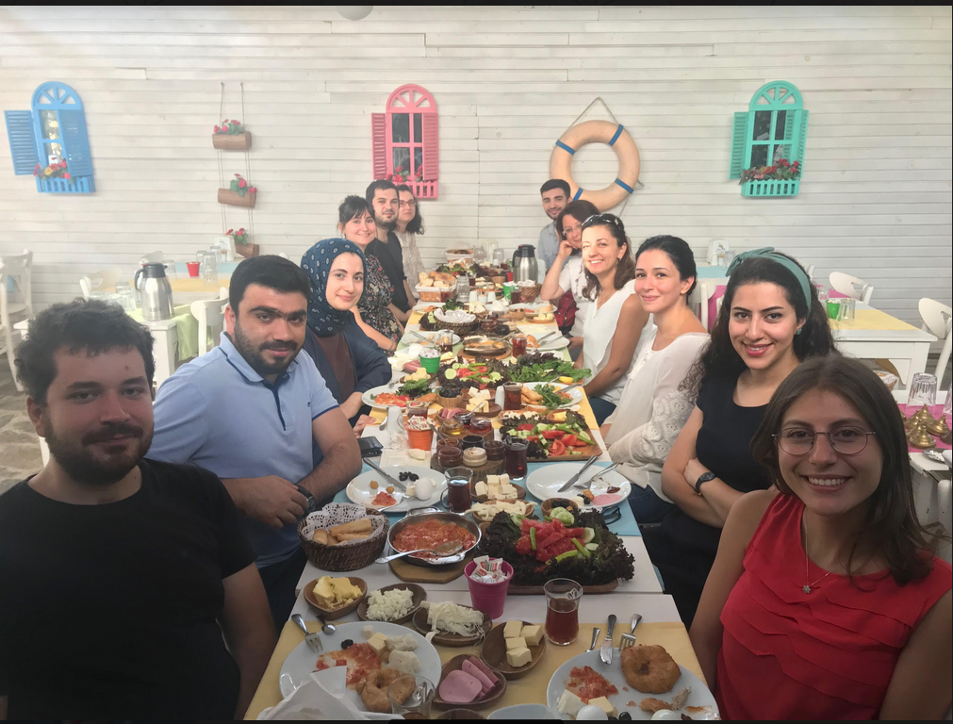
Nanomaterials, Energy, Molecular Modelling Group (NEMO)
Prof. Seda Keskin Avcı https://mysite.ku.edu.tr/skeskin/
NEMO is a computational research group working on molecular modeling of metal organic frameworks (MOFs).
Our research group is one of the leading groups on modeling of MOFs for energy applications in the world.
We have a very dynamic research group with members from all over the world.
We have a very productive group with a hiqh quality of publication and award record.
A Postdoctoral Fellowship is available: ERC-2017-STG project COSMOS (Computational Simulations of MOFs for Gas Separations)
Applicants: must have a PhD in Chemistry/Chemical Engineering/Materials Science or a relevant subject area.
research experience in computational modeling
strong oral and written communication skills in English

