Slide 1
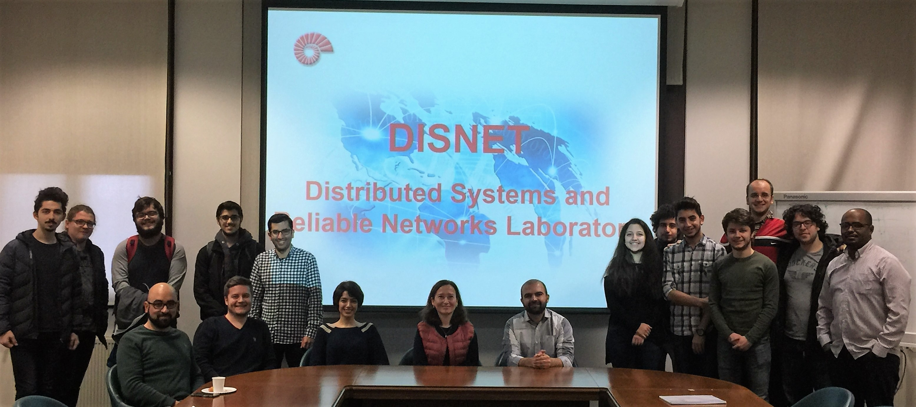


MSCA Postdoctoral Fellowships Hosting Offer
Distributed Systems and Reliable Networks Research Lab
Contact: Prof. Öznur Özkasap (oozkasap@ku.edu.tr)

Slide 2
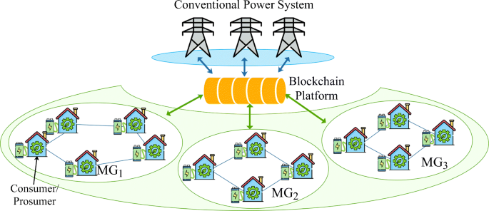
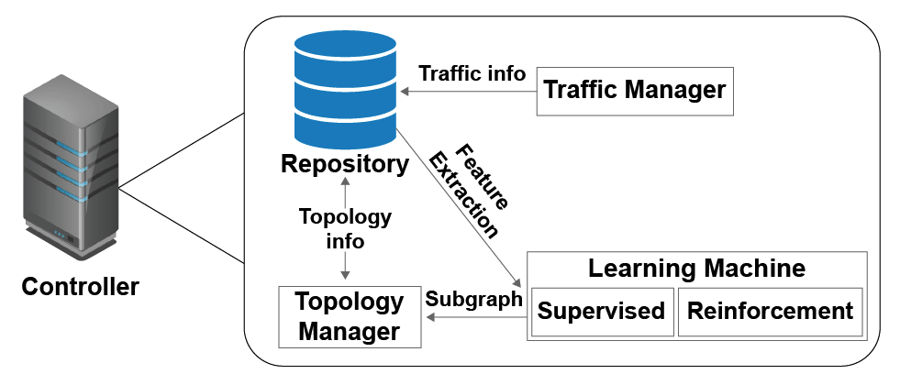
Distributed Systems and Reliable Networks (DISNET) Research Laboratory
Research Expertise
Distributed Computing Systems, Peer-to-peer Algorithms
Energy Efficiency, Reliable Network Protocols
Cloud and Edge Computing, Computer Networks
Security and Artificial Intelligence Distributed Systems
Sample Application Areas
  Blockchain-based Services
  Smart Grid and Internet of Energy
  IoT-based Systems
  Mobile and Vehicular Ad Hoc Networks
  Software Defined Networks
  Smart Healthcare

Slide 3
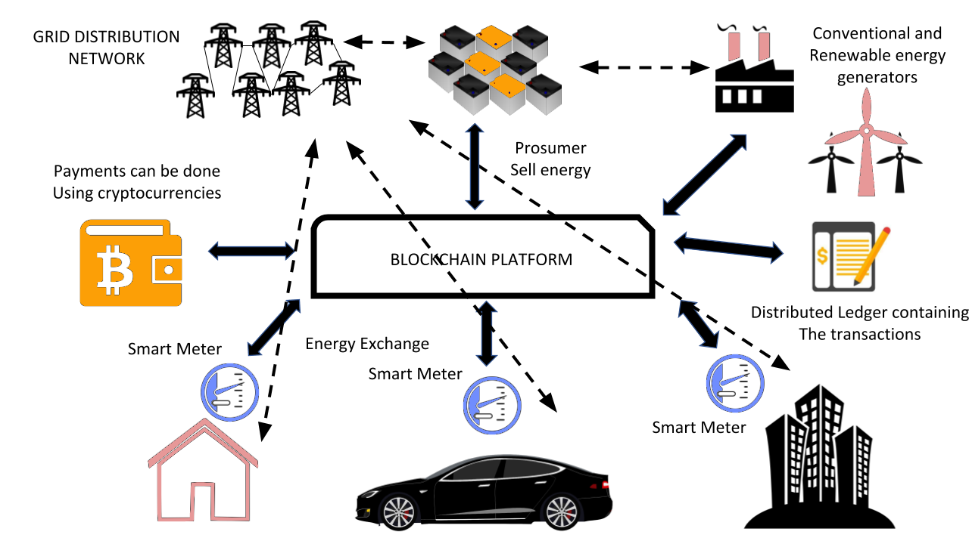
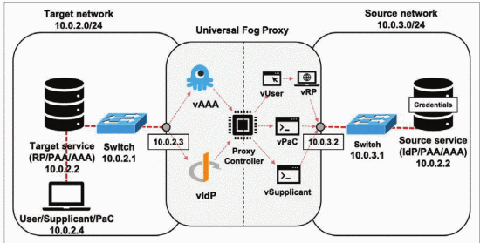
Distributed Systems and Reliable Networks (DISNET) Research Laboratory
SynergyNet Project:
Internet of Energy with Blockchain, Smart Contract and Federated Learning
TÜBİTAK 2247-A National Research Leaders Program Grant
Postdoctoral researcher position
Qualifications Required:
PhD in Computer Science / Engineering. Background and research experience on Distributed systems, Internet of Energy, Blockchain, Intelligent systems, Distributed federated learning, peer-to-peer (P2P) networks.
Interested MSCA-PF Postdoctoral researcher candidates can also apply for SynergyNet project.

Slide 4
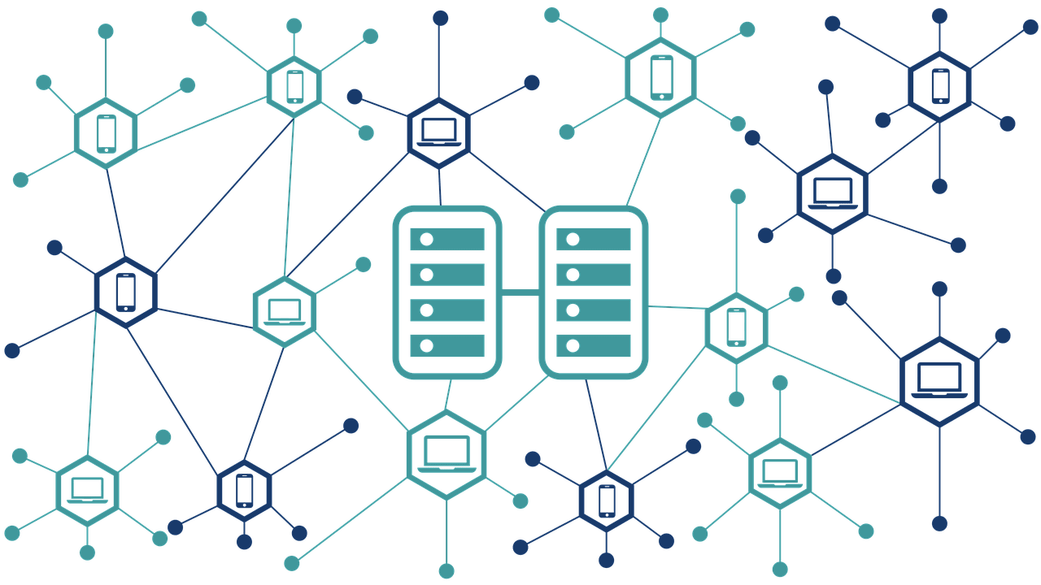
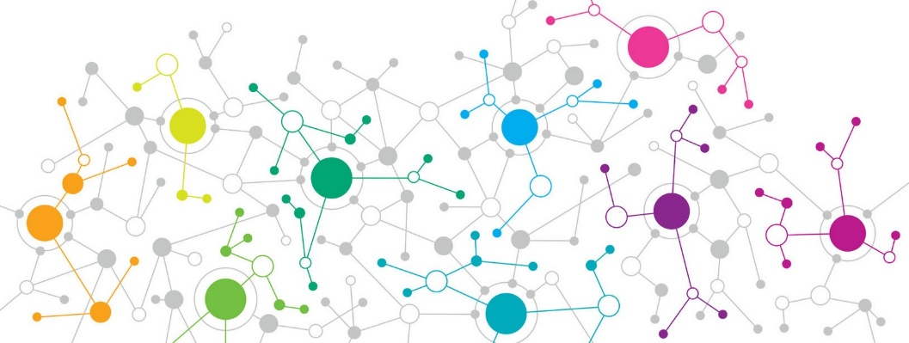
Related Recent Publications
O. Bouachir, M. Aloqaily, Ö. Özkasap, F.S. Ali, "FederatedGrids: Federated Learning and Blockchain-assisted P2P Energy Sharing", IEEE Transactions on Green Communications and Networking, 6(1): 424-436, March 2022. https://doi.org/10.1109/TGCN.2022.3140978
Ali, F.S., M. Aloqaily, O. Alfandi, and Ö. Özkasap. “Cyberphysical blockchain-enabled peer-to-peer energy trading”, IEEE Computer, 53(9): 56–65, September 2020. https://doi.org/10.1109/MC.2020.2991453
Ali, F.S., O. Bouachir, Ö. Özkasap and M. Aloqaily. “SynergyChain: Blockchain-assisted Adaptive Cyberphysical P2P Energy Trading”, IEEE Transactions on Industrial Informatics 17(8): 5769-5778, August 2021. https://doi.org/10.1109/TII.2020.3046744
Hassanzadeh-Nazarabadi, Y., A. Küpçü, Ö. Özkasap (2021), “LightChain: Scalable DHT-Based Blockchain”. IEEE Transactions on Parallel Distributed Systems 32(10): 2582-2593, October 2021. https://doi.org/10.1109/TPDS.2021.3071176

Slide 5

MSCA Postdoctoral Fellowships Hosting Offer
Distributed Systems and Reliable Networks Research Lab
Contact: Prof. Öznur Özkasap (oozkasap@ku.edu.tr)
Interested candidates are encouraged to contact by including CV and research statement.
Offer Details: EURAXESS site

