Slide 1
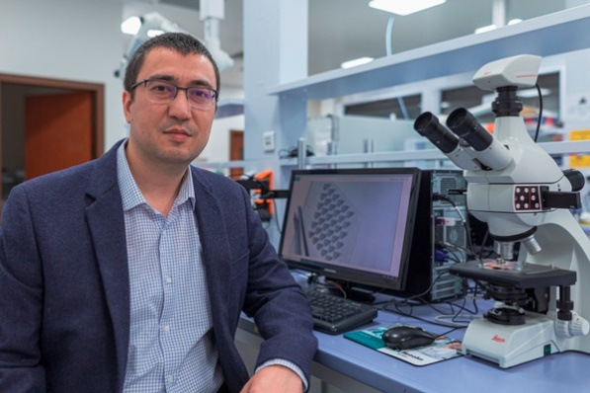
Prof. Levent Beker
AFFILIATIONS
Assistant Professor, Mechanical Engineering
Director, Bio-integrated microdevices laboratory
RESEARCH AREAS
Biosensors and Bioelectronics, wearable and implantable microdevices, wireless powering and communication
Selected awards and honors
2022 Starting Grant, Horizon Europe (2.5M Euro), European Research Council (ERC)
2021 National Young Investigator Award, BAGEP 2021, The Science Academy, Turkey
2020 International Fellowship for Outstanding Researchers (2232) (260K Euro), TUBITAK, Turkey
2019 MSCA Individual Fellowship, H2020 (150K Euro), PI of BrainWatch (ID: 840786)
2017 Postdocs at the Interface Seed Grant Award (50K USD), ChEM-H, Stanford University, U.S.
2017 Milliken Research Honorarium (1K USD), Milliken & Co., Spartanburg, SC, U.S.
2017 Best Poster Award, IAB Conference, Berkeley Sensor Actuator Center (BSAC), Berkeley, CA, U.S.
2015 Howard Hughes Medical Inst. (HHMI) Intl. Student Research Fellowship (43K/yr USD)
2014 Best Thesis of the Year Award, Middle East Technical University, Turkey
2013 Outstanding Oral Presentation Award, IEEE Transducers’13 Conference, Barcelona, Spain
2012 International Visitor Leadership Program (IVLP) sponsored by the U.S. Dept. of State
Publications in:
Nature Biomedical Engineering, PNAS, Science, Nature,
Nature Electronics
Prof. Levent Beker
Mechanical Engineering
Postdoc, Stanford University
Ph. D., University of California Berkeley
M.S., Middle East Technical University (METU)
B.S., Middle East Technical University (METU)
lbeker@ku.edu.tr
https://microdevices.ku.edu.tr/

Slide 2
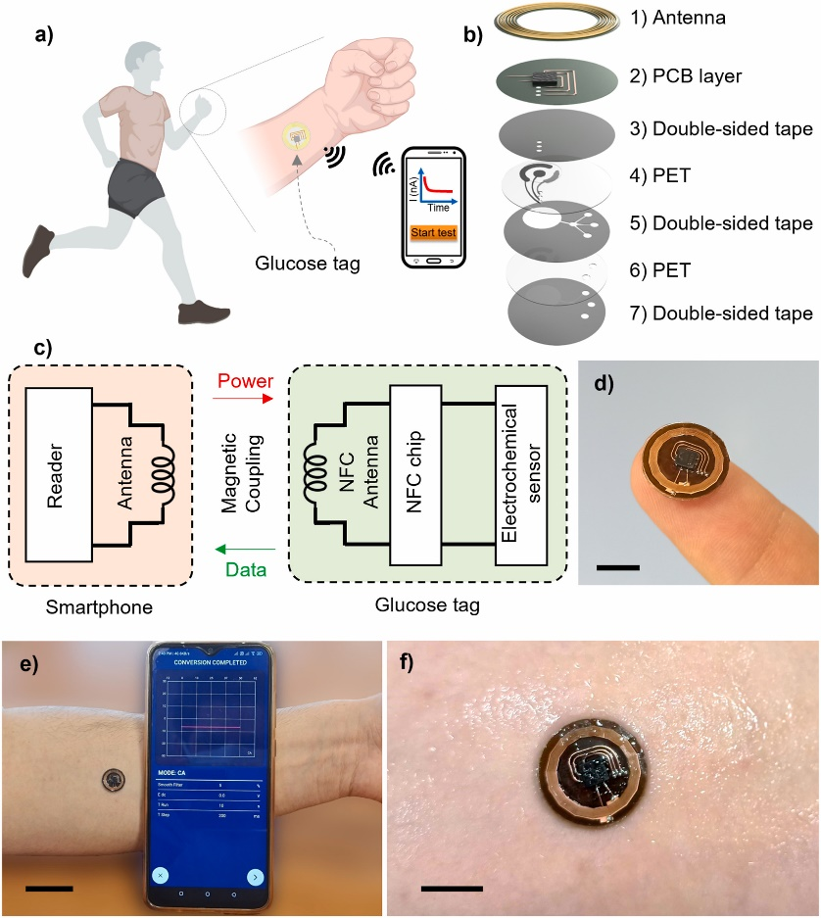
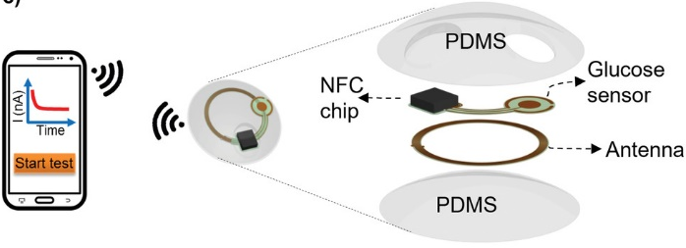
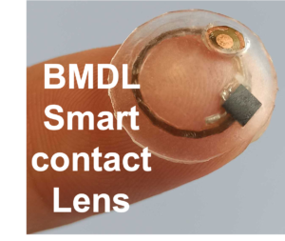
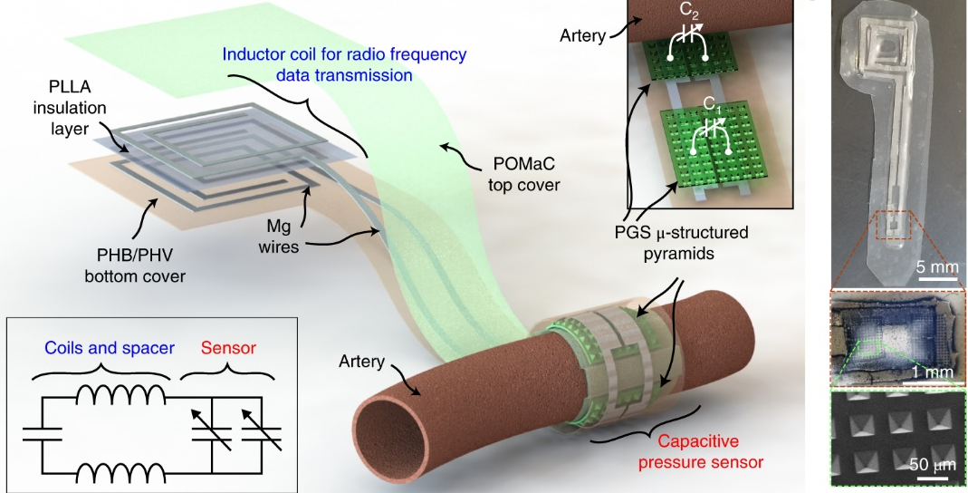

Wearable and implantable medical devices for continuous health monitoring
1) Noninvasive
2) Minimally invasive
Mirzajani, H., Istif, E., Abbasiasl, T., Mirlou, F., Özkahraman, E. E., Hasanreisoglu, M., & Beker, L. (2022). Femtosecond Laser Ablation Assisted NFC Antenna Fabrication for Smart Contact Lenses. Advanced Materials Technologies, 2101629.
3) Invasive
Mirzajani, H., Abbasiasl, T., Mirlou, F., Istif, E., Bathaei, M. J., Dağ, Ç., ... & Beker, L. (2022). An ultra-compact and wireless tag for battery-free sweat glucose monitoring. Biosensors and Bioelectronics, 114450.
Boutry, C. M., Beker, L., Kaizawa, Y., Vassos, C., Tran, H., Hinckley, A. C., ... & Bao, Z. (2019). Biodegradable and flexible arterial-pulse sensor for the wireless monitoring of blood flow. Nature biomedical engineering, 3(1), 47-57.

Slide 3
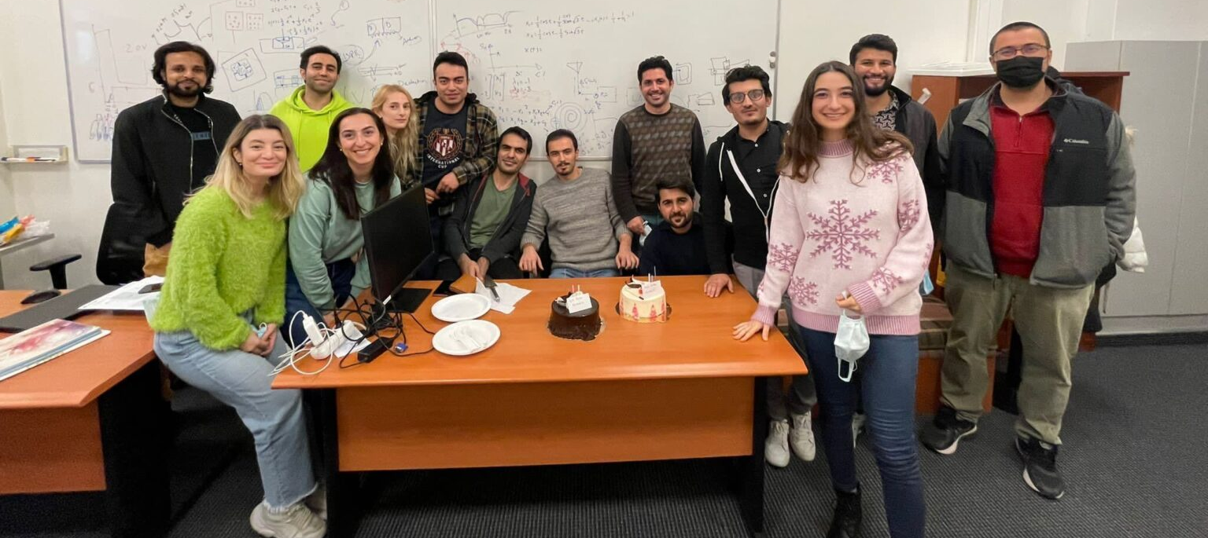



Infrastructure
Team
Funding
All required characterization equipment are available in the our lab
Full access to the Nanofabrication and Nanocharacterization Center
Access to Koc University Research center for translational Medicine for in-vivo experiments
Team members are: 3 postdoctoral researchers, 10 doctoral candidates, and 6 Master students
Opening:
- two postdoctoral researchers
- two research assistants

